Slide 1
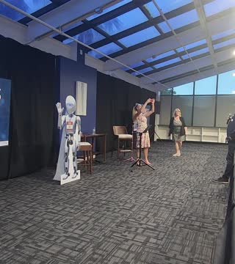
SPEAKER • EMCEE • EVENT HOST
ALISSA
MASTROPIETRO
Real-life teaching for rooms navigating change
Available for keynotes, moderated conversations, conferences, community events and brand experiences.
support@motomaid.com

Slide 2
THE WORK
People listen when they feel seen
A voice for
CHANGE
Alissa brings practical language to the moments people often hide: overwhelm, changing roles, clutter, pressure, and the gap between how life looks and how it feels.
REAL LIFE
FUNCTION
Her goal in every room is simple: make the next step feel possible.
BELONGING
ALISSA MASTROPIETRO
02

Slide 3
WAYS TO BOOK ALISSA
One communicator, three roles
KEYNOTE SPEAKER
PROFESSIONAL EMCEE
TRUSTED EVENT HOST
A focused message that gives audiences a useful idea, a memorable framework, and a clear next step.
A warm, prepared presence who keeps the agenda moving and helps speakers, sponsors, and guests feel supported.
A flexible guide for interviews, panels, community conversations, brand moments, awards, and live audience interaction.
In person or virtual • Domestic or international travel
ALISSA MASTROPIETRO
03

Slide 4
SIGNATURE TEACHING FRAMEWORK
The Reset Lens
A flexible teaching structure that can connect home, work, leadership, identity, and life transitions.
01
02
03
04
NOTICE
NAME
RESET
REALIGN
What is creating friction?
What changed beneath the surface?
What no longer supports the present?
What would make the next step easier?
ALISSA MASTROPIETRO
04

Slide 5
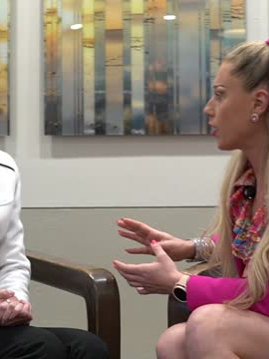
KEYNOTES AND TEACHING SESSIONS
Messages built around real turning points
THE SPACE IS TALKING
How our environments reveal changing needs before we have words for them.
FUNCTION OVER PERFECTION
A judgment-free approach to systems that work in real life.
WHEN LIFE CHANGES
How to recognize an old system, release shame, and build for the season you are in now.
ALISSA MASTROPIETRO
05

Slide 6
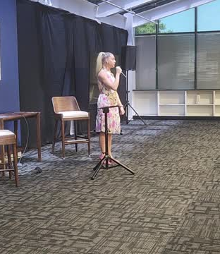
EMCEE AND HOST
A steady presence for the whole room
Alissa can support:
Opening remarks and audience welcome
Speaker introductions and transitions
Live interviews and panel moderation
Sponsor recognition and program continuity
Audience engagement and closing moments
Preparation starts with the event goals, audience, agenda, and tone.
ALISSA MASTROPIETRO
06

Slide 7
FLEXIBLE PROGRAMMING
Built for the room you are bringing together
AUDIENCES
FORMATS
Business owners
Teams in transition
Women’s leadership groups
Community organizations
Real estate and property professionals
Service-based businesses
Keynotes
Interactive workshops
Conference emceeing
Panel moderation
Fireside conversations
Virtual events
Every engagement can be shaped around the event theme and the change your audience is navigating.
ALISSA MASTROPIETRO
07

Slide 8
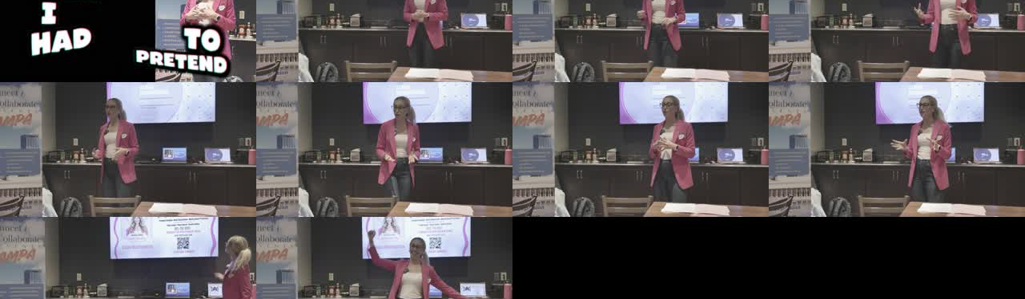
CONTENT THAT TRAVELS
One idea can live across a keynote, workshop, interview, panel, and short-form teaching series.
This gives event partners a message that can begin before the event and continue after the room clears.
ALISSA MASTROPIETRO
08

Slide 9
BOOKING AND COLLABORATIONS
Bring Alissa into the room
Keynote speaking
Professional emceeing
Event hosting and moderation
ALISSA
MASTROPIETRO
Speaker • Emcee • Host
support@motomaid.com
Available for events worldwide, subject to schedule and travel arrangements.

